Slide 1

Custom NER System
Olusanmi Hundogan

Slide 2
Agenda
Problem Overview
Dataset Analysis and Preparation
Software Architecture Overview
Model Selection & Overview
Finetuning Strategy & Results
Model Comparisons
Deployment Strategy
Improvements & Next Steps

Slide 3
Problem Overview
Given a Dataset containing text articles the Goal is to Build a custom NER system that outperforms generic models, is reproducible, and deployable under real-world constraints.
Dataset:
692 Rows
7 columns (including Text, Persons, Organisations and Locations)
Deliverables:
ML Pipeline
REST API
Evaluation of Results

Slide 4
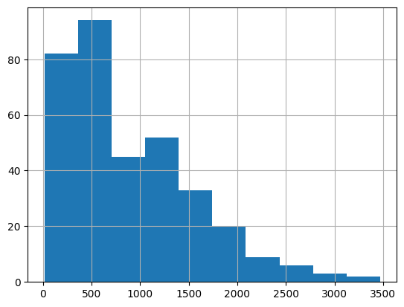
Dataset Analysis and Preparation
Token Distribution
Dataset
692 Rows
Texts were scraped from a CNN news site
Covers mostly politics
Follow common grammar rules
Maintained casing
Text-Structure
574 prefixed with “articleBody” followed by text
118 html documents containing the text
Entity Columns
Persons and Organisations separated by semicolon and structured in Entity,ID pairs. (e.g: Joe Biden,123; Angela Merkel,345;…)
Locations separated by commata
Persons were only in full names
Token Distribution
Based on GPT-4o Tokenizer

Slide 5
Dataset Preparation
Preparation Steps:
Remove IDs
Normalize delimiters
Extract text from HTML content
Remove “articleBody” prefixes
Split data into a dataset for finetuning and Evaluation

Slide 6
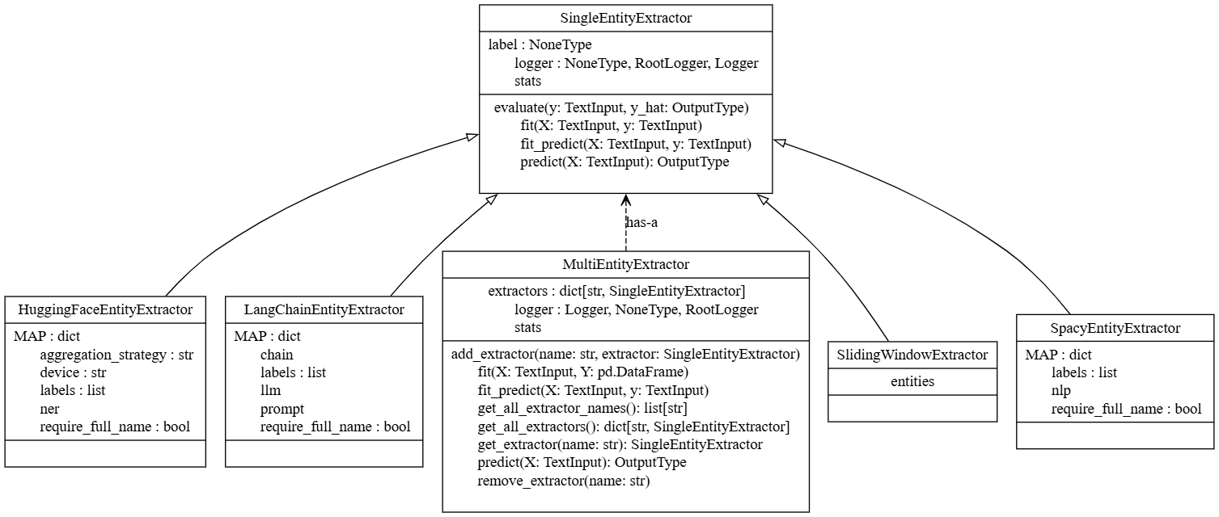
Software Architecture Overview
Follows Adapter Pattern
Configurability
Extensibility
Repeatability
Scikit-Learn Structure
Interoperability
Excellent Interface Design

Slide 7
Model Selection & Overview
Naïve Approach
Deterministic
Simple
Spacy NER
LLM
Huggingface NER Model
Finetuned NER Model
No generalization
Slow inference
Fast
No Training Necessary
No Domain Specificity
Zero Shot
Flexible
Costly
Inconsistent
Slow
No Training Necessary
Slow without GPU
No Domain Specificity
Allows for Domain Adaptation
Slow without GPU
Requires quality training data

Slide 8
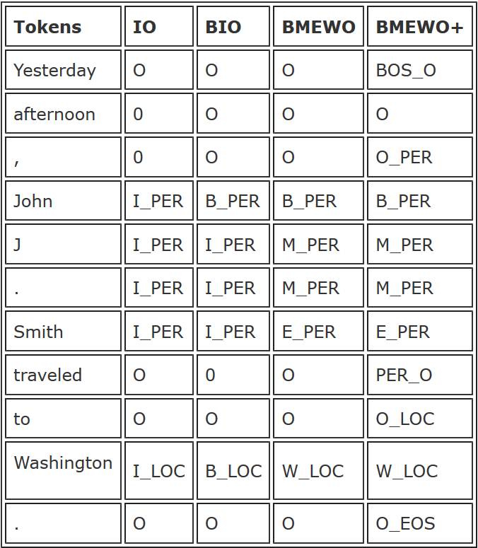
Finetuning Strategy & Results
Base for finetuning: dslim/distilbert-NER
Use of ChatGPT-4o-mini to label tags in IOB format
Hinge-Loss + Dropout to address class imbalance.
Text-splitting to increase data samples to avoid context rot

Slide 9
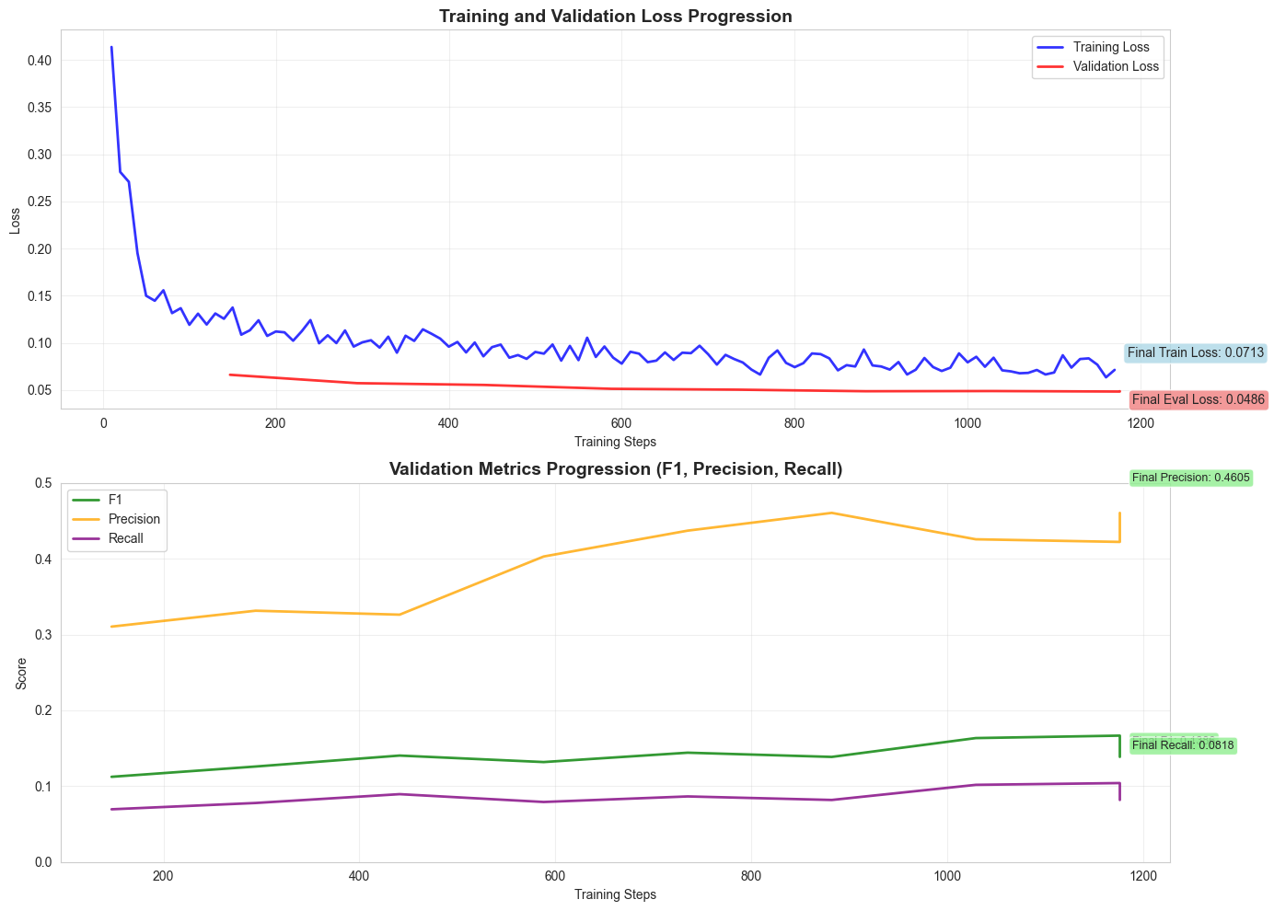
Finetuning Results
Loss decreases consistently
Eventually training loss falls below evaluation loss which indicates overfitting
Precision
Increases sharply in the first few Epochs
Decreases after a couple of Epochs
Recall increases
Steady increase
Low
F1 increases
Steady increase
Mostly determined by the low recall
We mitigate this through Early Stoppage

Slide 10
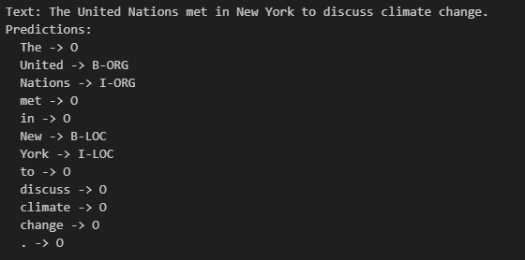
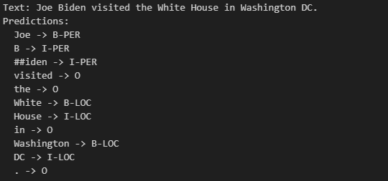
Finetuning Results
Short Examples seem to work well
Longer Examples work less

Slide 11
Improvements & Next Steps
Model Development
Software ENGINEERING
Finetuning
Produce a bigger finetuning dataset
Apply more cleaning of the finetuning dataset
Introduce oversampling/undersampling to handle class imbalances
Exploration
Reformulation of NER (Multiclass-Classification) Task to Text-Generation
Finetuning of LLama3.1 8b or Llama3.2 1b
Coming soon…

Slide 12
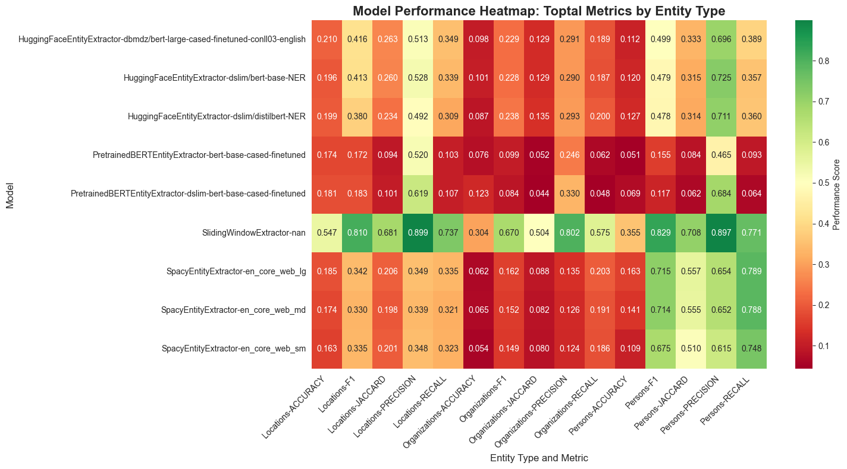
Model Comparison

Slide 13
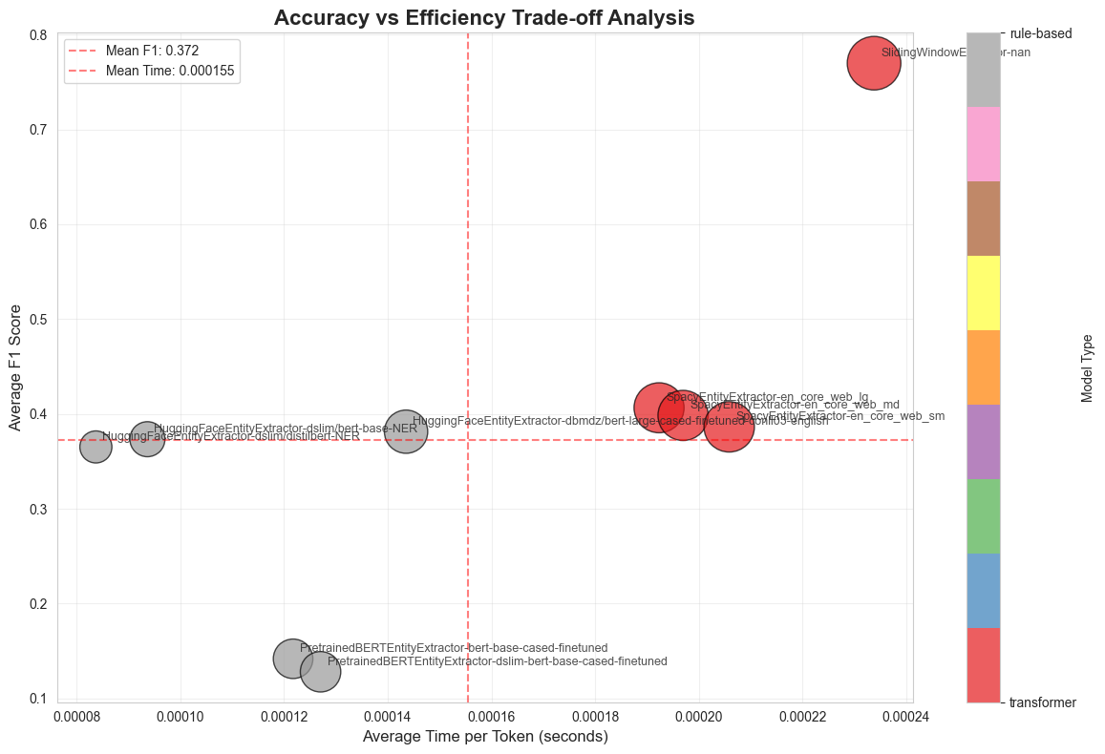
Model Comparison

Slide 14
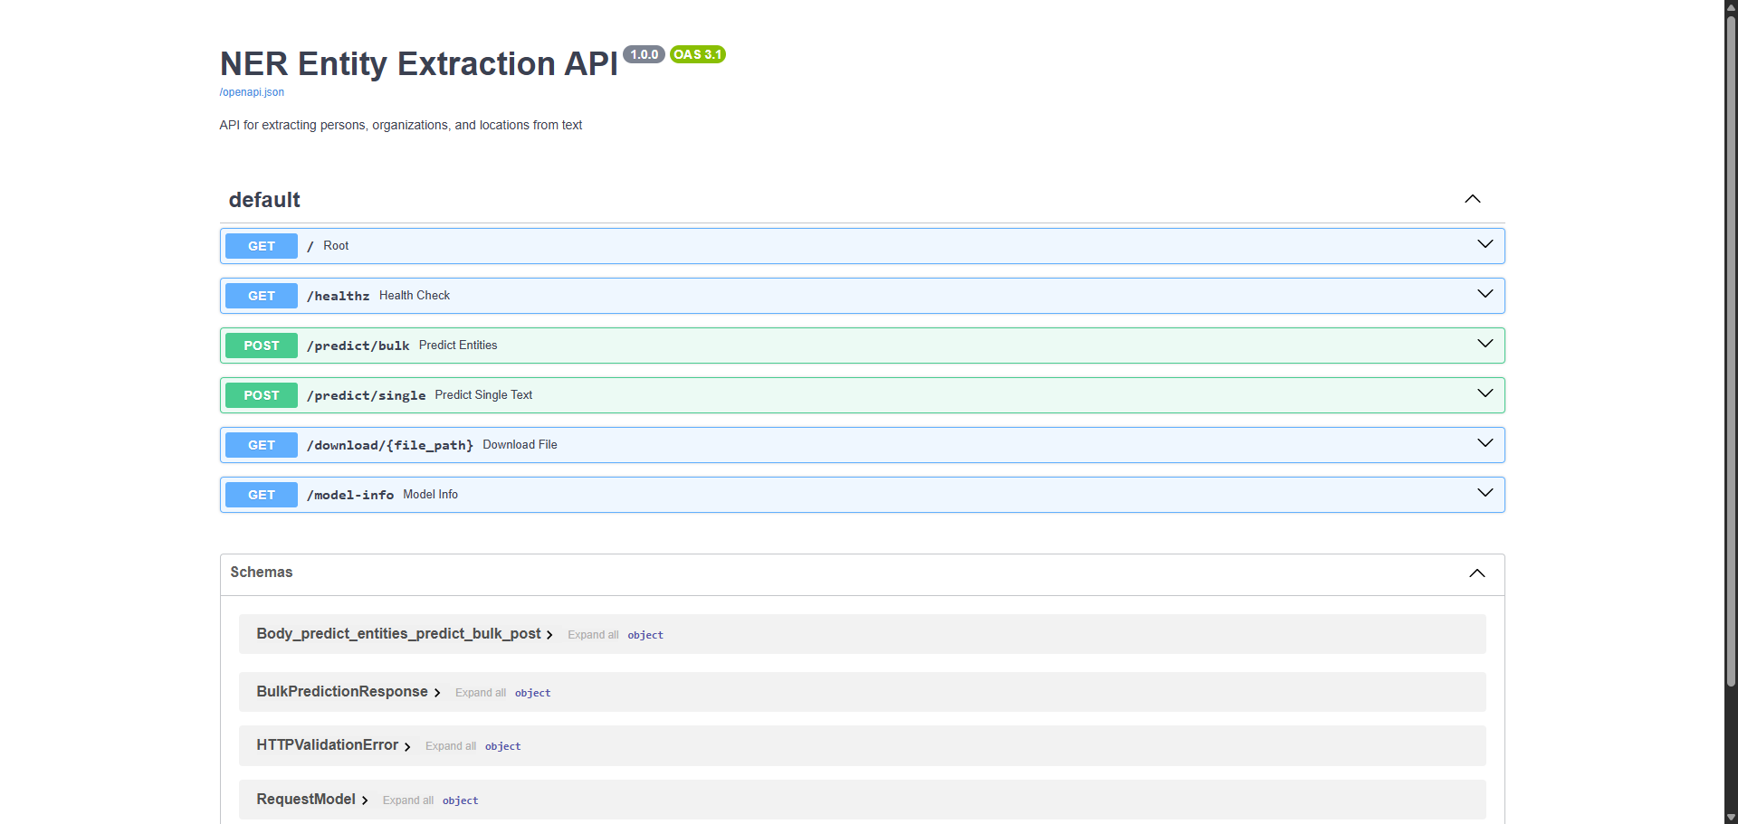
Deployment Strategy
Deployment using a REST-API
Based on FastAPI
Automatically Generates OpenAPI-Documentation
Runs on uvicorn application server with 1 worker
Containerized using Docker and Docker-Compose
Docker compose was used to allow for volume binds and runtime environment but was not strictly necessary

Slide 15
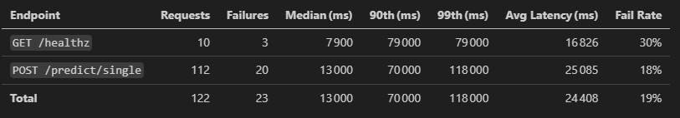
Deployment at Scale
Application does not scale with the chosen configuration
Deployment of the HF model could only be on CPU
Usage of a single worker

Slide 16
Improvements & Next Steps
Model Development
Software ENGINEERING
Finetuning
Produce a bigger finetuning dataset
Apply more cleaning of the finetuning dataset
Introduce oversampling/undersampling to handle class imbalances
Exploration
Reformulation of NER (Multiclass-Classification) Task to Text-Generation
Finetuning of LLama3.1 8b or Llama3.2 1b
Scaling Issues
Setting up GPU usage in Docker
Deploy application on a platform with autoscaling capabilities (Kubernetes)
Using a message queue system like Kafka and pool requests to leverage parallel GPU processing
General Improvements
Introduce automated testing with Pytest
Include CI/CD
Optimise Docker build to reduce container size

